Slide 1
ACCELERATE YOUR POTENTIALS
FRENCH LEADER IN DIGITAL GROWTH.
GROWTH AND EFFICIENCY FOR SMEs AND ETIs.
JANVIER 2023

Slide 2
CONSULTING AND SUPPORT FOR DIGITAL GROWTH
ÉDITO
Technology, far from distancing us, contributes to our sense of cohesion. It revolutionizes the business world and disrupts the practices of our clients, both in their professional activities and in their relationships with customers, suppliers, and employees.
The Information System, at the core of the company, is no longer just a technical matter but a key strategic issue.
As you have understood, digital transformation is a major challenge for SMEs and ETIs. In order to drive company growth, the IT system must align with the strategy, taking into account business and operational challenges.
We have built NowBrains Group on this realization and have implemented this vision within our own organization. For over 20 years, we have been supporting companies in accelerating their potential and growth through IT outsourcing, digital strategy, IT development, and security.
The complementarity of our various professions provides us with a 360° understanding of business, human, and technical challenges. Creating value around the IT system is accompanied by CSR (Corporate Social Responsibility) challenges.
Recognizing that collective effort is required to address current challenges and prepare for the future, we are committed to a more responsible digital approach and actively participate with all our resources. It is essential to bring meaning to our teams, our organization, and our clients. This seamless connection enables us to collectively press the keys of a keyboard with multiple functionalities: efficiency, inclusivity, sustainability, and fulfillment.
Anchored in our DNA, our pragmatic approach will leave its mark on the world of tomorrow.
2

Slide 3
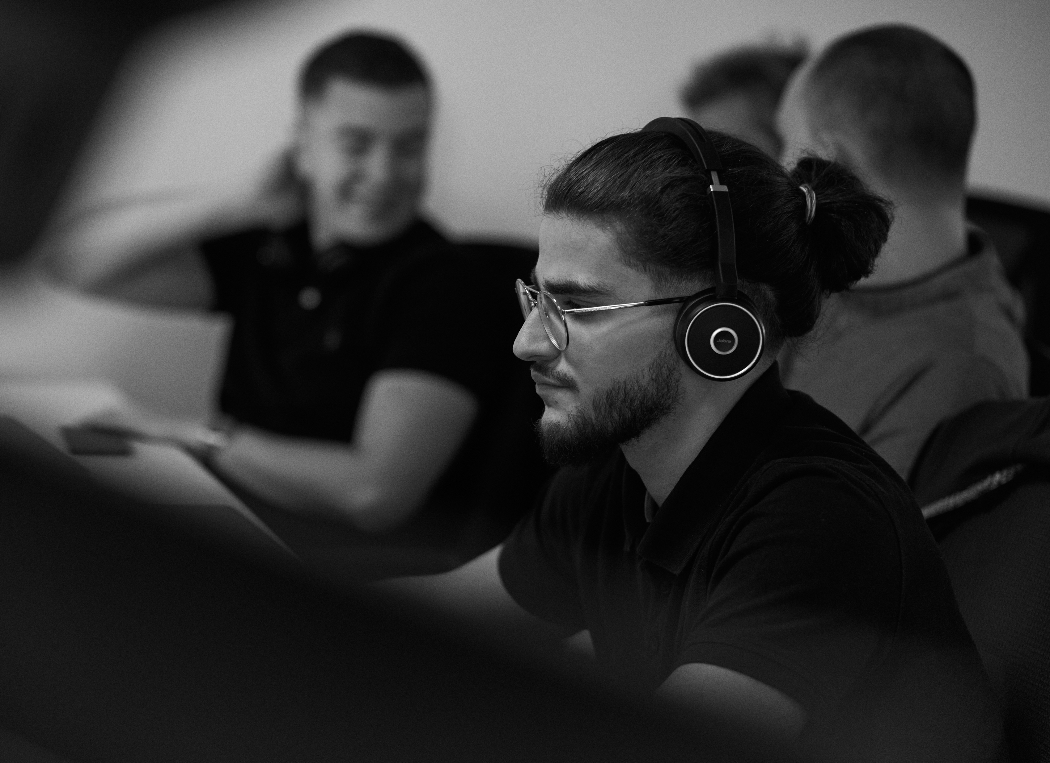
WHO ARE WE ?
3

Slide 4
4 AREAS OF EXPERTISE: DIGITAL TRANSFORMATION AND IT EXPERTISE
WHO ARE WE ?
OUR GROUP
NowBrains is an independent French group that has been supporting SMEs and ETIs since 2003 in digital transformation and Information Systems challenges.
Our mission is to harness and unlock your potentials with the sole objective of accelerating your business through optimization of your operational organization (processes, tools, team...) while maintaining constant alignment with your strategy.
DEVELOPMENT,
INNOVATION AND DATA
CONSULTING AND STRATEGY
CYBERSECURITY
IT OUTSOURCING
4

Slide 5
WHO ARE WE ?
OUR GROUP
2023
IAKAA
SECUGÉRANCE
2018
2021
New Iakaa strategy and launch of Secugérance with NowCyberDefense.
2015
NOWLAB
NOWSOC
NOWLEADS
Launch of NowLab
NOWRESEARCH
2008
Creation of NowLeads
Creation of NowSOC
and NowResearch
Objective : 20M€
150 collabs.
NOWSERV
7M€
45 collabs.
16M€
120 collabs.
Creation of the first Data Center
3,5M€
30 collabs.
2,5M€
20 collabs.
13M€
100 collabs.
11M€
85 collabs.
2022
11M€
12 collabs.
9M€
60 collabs.
NOWSERVICEDESK
300K€
4 collabs.
Launch of NowServiceDesk
2012
2020
IAKAA
2019
NOWBRAINS
2003
Launch of Iakaa
Unification of entities under a new identity
NOWDSI
Creation of NowTeam: outsourcing offer
Launch of NowDSI
6

Slide 6
DIGITAL GROWTH FOR ALL BUSINESSES
WHO ARE WE ?
OUR VISION
To ensure growth, IT must align with business strategy. Regardless of your size, whether you're a small business (TPE), SME, or ETI, the IT system must be in line with your specific needs, challenges, constraints, and business objectives.
In 20 years of existence and growth, we have gone through successive stages of this alignment. That's why we support our clients in a highly pragmatic manner by improving the functionality and performance of their IT infrastructure. This is made possible through a comprehensive, technical, functional, and organizational understanding of the IT system.
Support and strategic vision
Organizational agility
Anticipation of business needs
Involvement of multidisciplinary teams
7

Slide 7
WHO ARE WE ?
OUR KEY RESOURCES
More than 150 people work daily for our clients.
100
15
15
20
Dedicated experts in managed services, security, cloud, and digital workplace.
CIO in part time
Digital experts and web development
Employees are dedicated to the Group's support functions, including administrative management, marketing, and sales assistance.
8

Slide 8
WHO ARE WE ?
AN EFFECTIVE GEOGRAPHIC NETWORK
More than 150 people work daily for our clients.
Our 17 agencies located throughout France, Switzerland, Belgium, and Luxembourg enable us to provide quality support and maintain proximity to our clients.
Our teams are spread over all of these agencies, each of which has :
An agency manager, local technicians and business consultants.
RÉGION NORD
RÉGION EST
SUISSE
BELGIQUE
LUXEMBOURG
Lille
+ 33 (0)3 74 09 57 00
Strasbourg
+ 33 (0)3 74 09 57 00
Lausanne
+ 41 (0)2 51 19 08 10
Bruxelles
+ 41 (0)2 51 19 08 10
Luxembourg
+ 41 (0)2 51 19 08 10
RÉGION CENTRE IDF
RÉGION CENTRE EST
RÉGION OUEST
RÉGION SUD OUEST
RÉGION SUD EST
Paris 9ème
+ 33 (0)1 61 37 35 90
Élancourt
+ 33 (0)1 61 37 35 90
Lyon
+ 33 (0)4 28 29 50 90
Grenoble
+ 33 (0)4 58 00 55 50
Nantes
+ 33 (0)2 85 52 45 05
Rennes
+ 33 (0)2 85 52 45 05
Brest
+ 33 (0)2 85 52 45 05
Bordeaux
+ 33 (0)5 35 54 68 32
Toulouse
+ 33 (0)5 82 95 81 88
Aix en Provence
+ 33 (0)4 22 13 25 51
Nice
+ 33 (0)4 22 13 25 51
Montpellier
+ 33 (0)4 72 19 67 68
9

Slide 9
WHO ARE WE ?
GROUP VALUES
LEARNING ORGANIZATION
HONESTY AND TRANSPARENCY
Internal evolution and constant enrichment of the teams.
A guarantee of the right solution for the right customer based on our own experience.
WELL-BEING
REQUIREMENT AND RELIABILITY
Fulfillment of teams in a caring and healthy environment.
A guarantee of a long-lasting, well thought out and adapted solution.
AGILITY AND PRAGMATISM
Rooted in our DNA, our pragmatic approach allows us to prioritize the most fundamental issues, and our agility enables us to provide quick and adaptable responses.
10

Slide 10
WHO ARE WE ?
OUR CSR COMMITMENTS
HEALTH AND WELL-BEING OF EMPLOYEES
Maintaining the well-being of our employees is a priority for us. We prioritize the fulfillment of each employee through various arrangements such as telework, cultural and sports activities, team building, and more.
EQUAL OPPORTUNITIES
Guarantee diversity and promoting the principle of non-discrimination in all its forms. Providing support and training to our employees through NowSchool, our internal certification platform.
RESPONSIBLE CONSUMPTION AND PRODUCTION
Commitment to environmental approach: finding a balance between resource usage and reducing our carbon emissions. The equipment we offer is sourced from the "Green IT" range.
IT EQUIPMENT RECYCLING
Strengthening the second life activity and actively participating in reducing our environmental impact related to digital technology: sustainable IT approach.
11

Slide 11
WHO ARE WE ?
OUR CERTIFICATIONS
COMING IN 2023
ITIL V4
ISO 9001
Customer service
Happy Index®
at Work
ISO 27001
[Roadmap 2023]
Our teams are trained in ITIL standards to ensure the efficiency of our service with a strong alignment to your current and future business needs.
This standard attests to our ability to implement effective quality management for consistent service quality. It highlights our strong customer orientation, process approach, and continuous improvement mindset.
The entire NowBrains group is proud to be certified by ChooseMyCompany® for the Happy Index®atWork label. It is a recognition of our shared approach to collaboration in the workplace.
We are strongly committed to protecting our clients' data and take precautions to prevent any security breaches associated with such risks.
12

Slide 12
OUR EXPERTISE
13

Slide 13
OUR EXPERTISE
OUTSOURCING
Ensuring the operation of your IT systems in all circumstances and providing user support.
We have targeted the specific needs of each VSE / SME / ETI.
Our offerings are tailored and dedicated to each of our target segments.
Indeed, each VSE / SME / ETI must offer its employees a workspace integrating all the tools, applications and documents necessary for everyday life to carry out their missions.
Our approach enables us to better support businesses through 3 brands:
Are you a VSE ?
Iakaa offers a customized solution for reliable IT services. Our team of experts is dedicated to meeting the needs of VSEs (small businesses) : 1 to 15 workstations.
Are you a SME ?
NowTeam supports SMEs in the management, operation, and evolution of their IT systems. Through a range of managed IT services, SMEs benefit from daily IT management by expert professionals.
Are you a ETI ?
NSD revolutionizes the service desk market with an innovative service supported by artificial intelligence: its NIA (NSD Intelligent Assistant). The NSD solution addresses the productivity needs of businesses and user satisfaction.
14

Slide 14
OUR EXPERTISE
CYBERSECURITY
360° security for your Information System.
Complete security solutions to support your challenges :
Ensuring the reputation and image of your company
Ensuring the protection of your most sensitive data
Mitigating financial risks
Ensuring business continuity and production continuity
Adapt your level of security to current risks and challenges. The SOC team adjusts your strategy and ensures an optimal level of security for your IT system according to your needs.
SOC
v
The SOC has several essential roles :
Continuous protection of the network and all equipment of your Information System.
Identification of threats and implementation of automated and swift remediation actions.
Supervision, investigation, and response by our security operators for the handling of the most complex threats.
15

Slide 15
OUR EXPERTISE
CONSULTING AND STRATEGY
The Information System represents a significant part of the value creation of a company.
Digital strategy and IT strategy are increasingly intertwined within a company. NowBrains offers comprehensive support solutions to accelerate the growth of the company through its two brands : NowDSI and NowLeads.
Boost the performance of your company by aligning your IT system with your strategy..
Our specialized experts support you with an adapted approach :
A Minimum Viable Strategy
SI Audit
Change management support
IT governance
Interim CIO or part-time CIO
16

Slide 16
OUR EXPERTISE
DEVELOPMENT, INNOVATION AND DATA
Our research and development department uses advanced technologies to process data and provide new tools to our clients. Data, the main asset of a company, is also the most complex to exploit.
NowBrains' approach is to support you in making informed decisions through the use of data and to address all the challenges related to IT and information systems with its 2 brands : NowLab and NowResearch.
Our R&D team tests and develops new applications to accelerate the strategy and growth of our clients :
Big Data
Technological innovation and AI (NIA)
ITSM ecosystem (NowBoard)
Machine Learning
Data Sécurity
17

Slide 17
FINANCIAL AND COMMERCIAL DATA
20

Slide 18
FINANCIAL DATA
FINANCIAL DATA
Some financial data of the Group :
CONSULTING AND STRATEGY
CYBERSECURITY
DEVELOPMENT, INNOVATION AND DATA
+23%
Group revenue growth over the past 3 years :
+18%
2M€
500K€
1,5M€
Constantly evolving, our Group achieved a turnover of 16 million euros in 2022, distributed as follows :
12M€
11M€
13M€
16M€
OUTSOURCING
FINANCIAL
RESULT (en K€)
2021
2022
2023 (projected)
With an increase of over 23% compared to 2021, Nowbrains achieved a revenue of 16 million euros in 2022.
REVENUE
13 M
16 M
20 M
NET PROFIT
957
1150
21

Slide 19
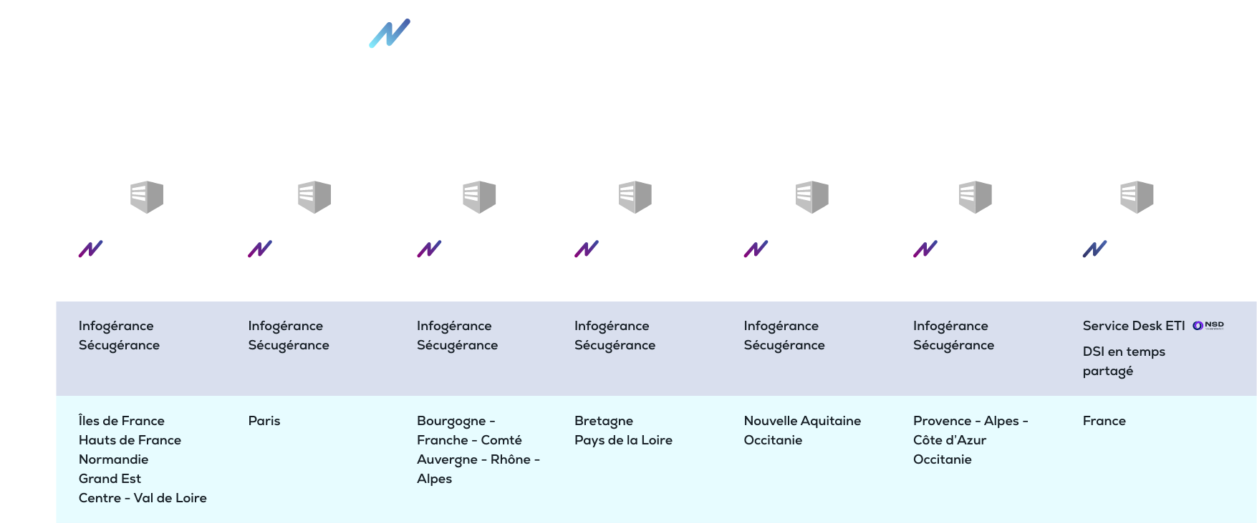
LEGAL ENTITIES
LEGAL ENTITIES
The NowBrains group was initially formed through IT outsourcing services and later expanded into complementary activities to provide value around the information system. In order to meet client needs and accelerate growth, the development led to the opening of branches in different regions of France. Each branch is a legal entity connected to the group and managed by a director associated with the results of their region. To oversee the complementary activities, other entities were created, with each activity having its own legal structure. Depending on the services subscribed to in a contract with the group, multiple entities are involved in the billing process. Here is a comprehensive representation of the entities that make up the group.
22

Slide 20
Client references
A FEW REFERENCES
23

Slide 21
OPERATIONAL DATA
24

Slide 22
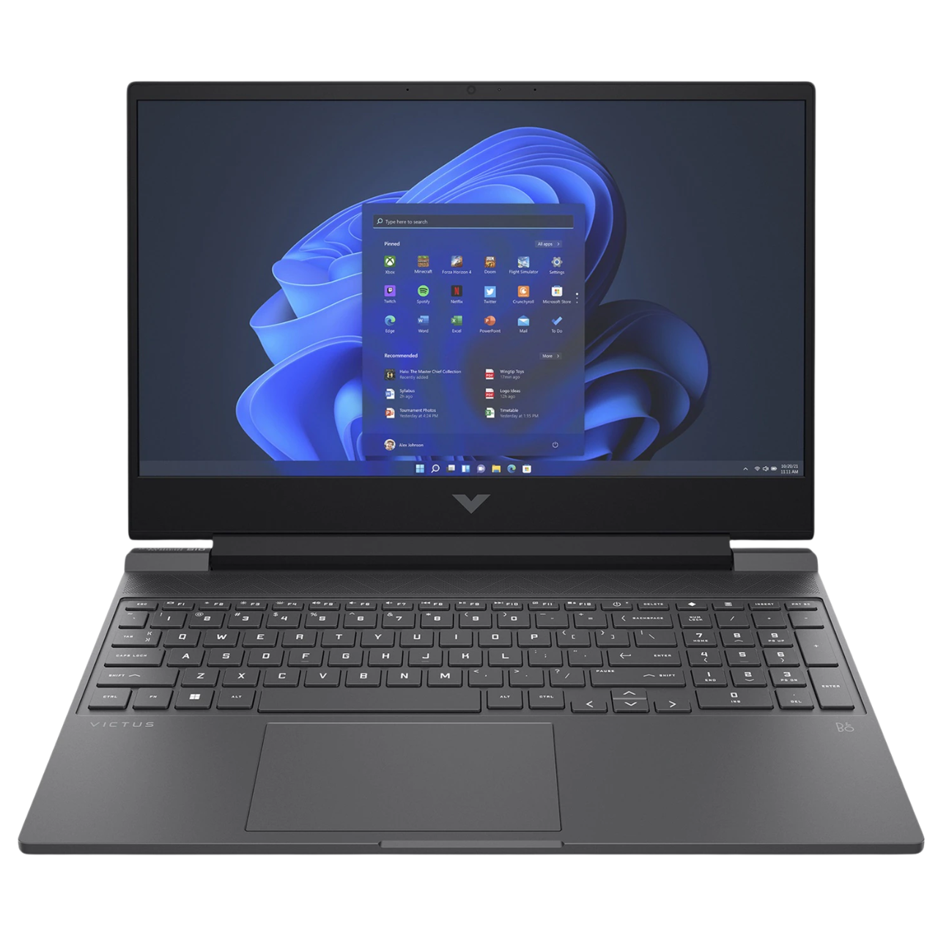
OPERATIONAL DATA
PASSIONATE INDIVIDUALS AT YOUR SERVICE
CYBERSECURITY
820
PHYSICAL SERVERS
400 000
BLOCKED ATTACKS
400 PROTECTED CLIENTS
3 500
VIRTUAL SERVERS
5M
OF EVENTS ANALYZED EVERY DAY
24 320
IT Equipment managed and maintained by NowTeam.
18 000
SUPPORTED USERS
2 000
SECURE WEBSITES
20 sec
Creation of a ticket in just 20 seconds
87,5 %
Good qualification rate
15 CIO
In 2022, NowDSI deployed 15 CIO at our clients' locations to optimize the efficiency of their Information Systems.
OUR OBJECTIVE :
Providing the right answer, at the right time, to the right person.
99 %
Rate of successful resolution by augmented technicians.
7,5 X
Reduced user downtime per year
25

Slide 23
THE EXECUTIVE TEAM
26

Slide 24
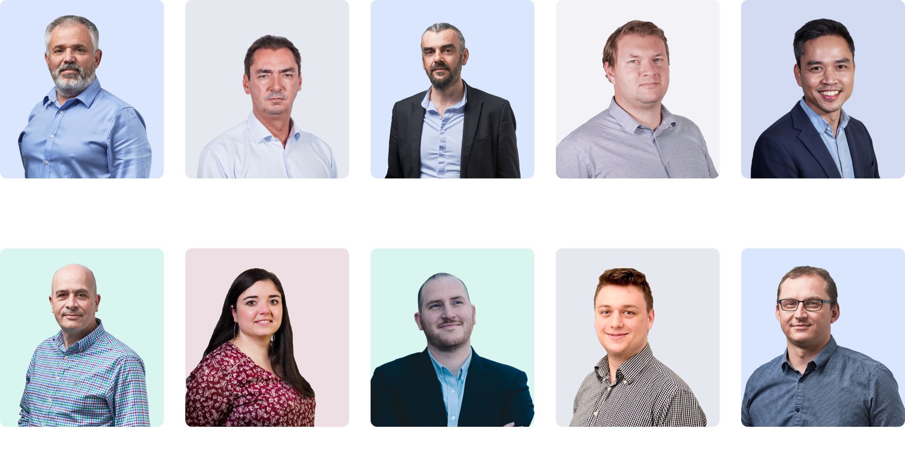
THE EXECUTIVE TEAM
PASSIONATE AT YOUR SERVICE
27

